Slide 1
Report on Hotel Booking Analysis
Prepared by Shakil Ahammed

Slide 2

Business Problem
In recent years, City Hotel and Resort Hotel have seen high cancellation rates. Each hotel is now dealing with a number of issues as a result, including fewer revenues and less than ideal hotel room use. Consequently, lowering cancellation rates is both hotels' primary goal in order to increase their efficiency in generating revenue, and for us to offer thorough business advice to address this problem.
The analysis of hotel booking cancellations as well as other factors that have no bearing on their business and yearly revenue generation are the main topics of this report.

Slide 3
Assumptions
1. No unusual occurrences between 2015 and 2017 will have a substantial impact on the data used.
2. The information is still current and can be used to analyze a hotel's possible plans in an efficient manner.
3. There are no unanticipated negatives to the hotel employing any advised technique.
4. The hotels are not currently using any of the suggested solutions.
5. The biggest factor affecting the effectiveness of earning income is booking cancellations.
6. Cancellations result in vacant rooms for the booked length of time.
7. Clients make hotel reservations the same year they make cancellations.

Slide 4
Hypothesis
1. More cancellations occur when prices are higher.
2. When there is a longer waiting list, customers tend to cancel more frequently.
3. The majority of clients are coming from offline travel agents to make their reservations.

Slide 5
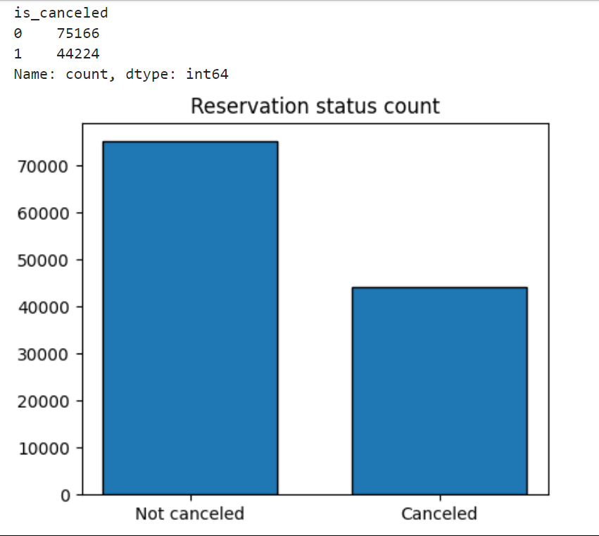
Analysis and Findings
The bar graph shows the percentage of reservations that are canceled and those that are not. It is obvious that there are still significant number of reservations that have not been canceled. There are still 37% of clients who canceled their reservation, which has a significant impact on the hotels earnings.

Slide 6
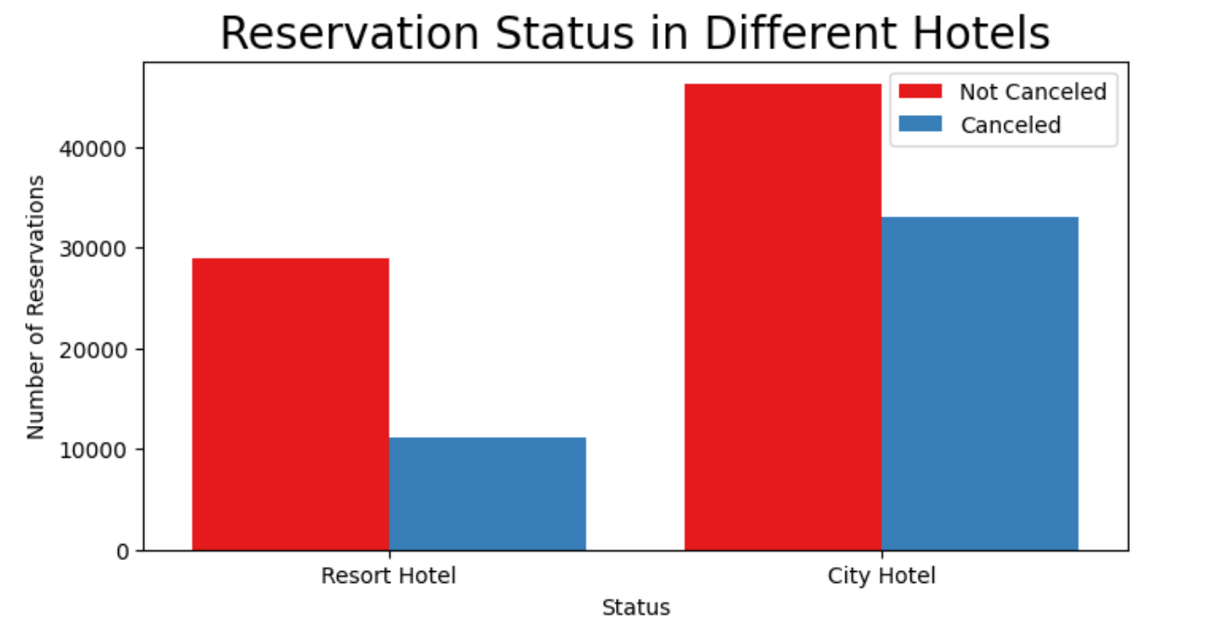
In comparison to resort hotels, city hotels have more bookings. It's possible that resort hotels are more expensive than those in cities.

Slide 7
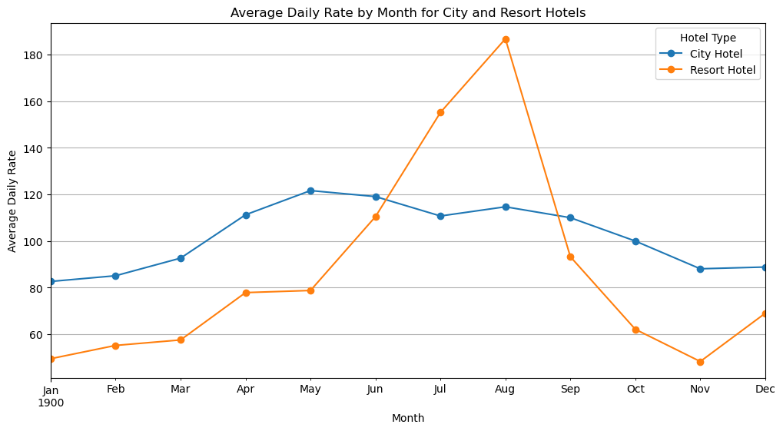
﻿The line graph shows that, on certain month, the average daily rate for a city hotel is less than that of a resort hotel, and on other month, it is even less. It goes without saying that weekends and holidays may see a rise in resort hotel rates.

Slide 8
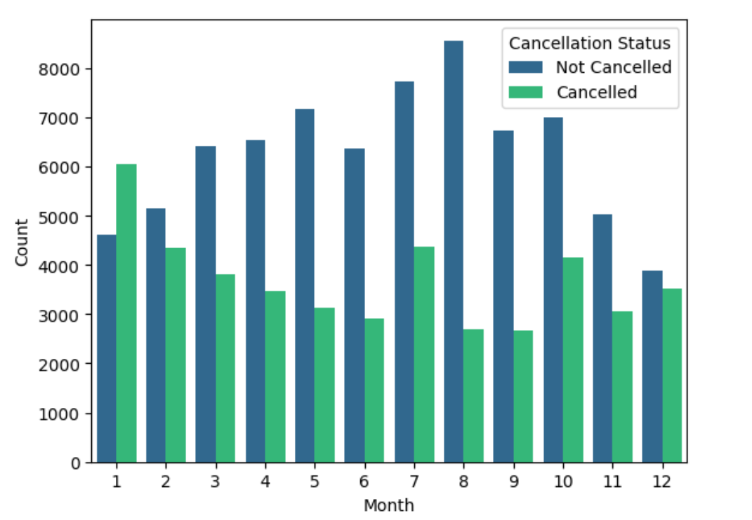
Bar graph shows that the months with the highest and lowest reservation levels according to reservation status. As can be seen, both the number of confirmed reservations and the number of cancelled reservations are largest in the month of August. whereas January is the month with the most cancelled reservations.

Slide 9
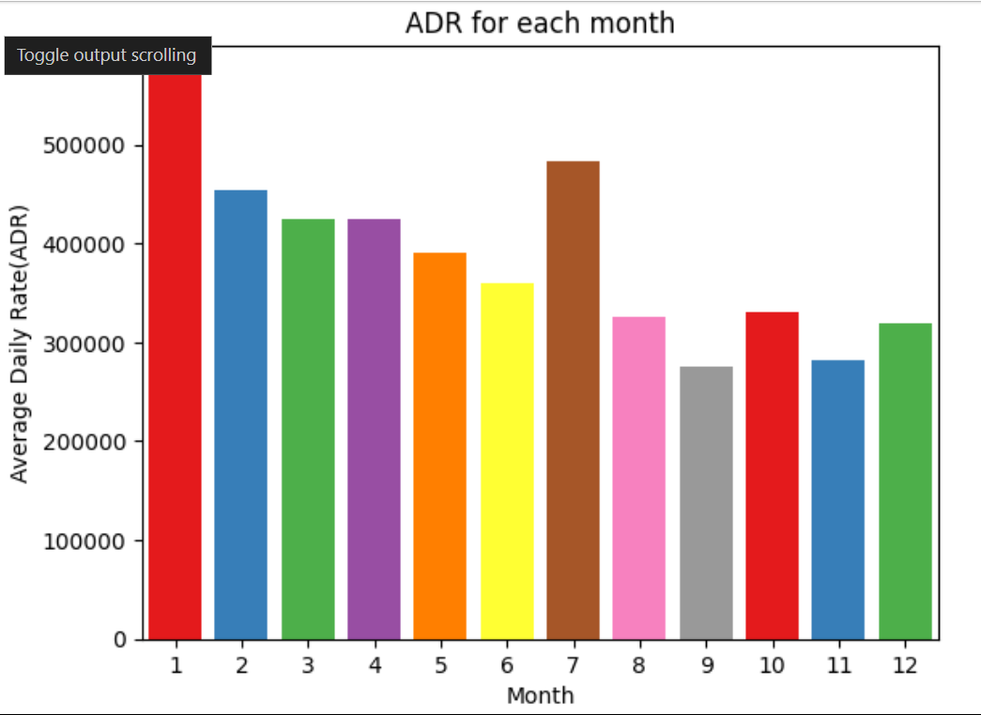
This bar graph demonstrates that cancellations are most common when prices are greatest and are least common when they are lowest. Therefore, the cost of the accommodation is solely responsible for the cancellation.

Slide 10
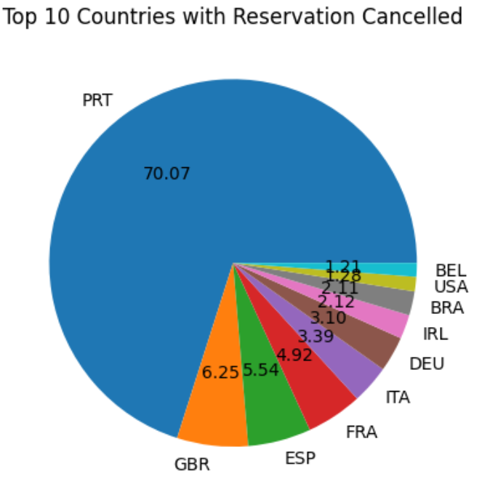
The top country is Portugal with the highest number of cancellations.

Slide 11
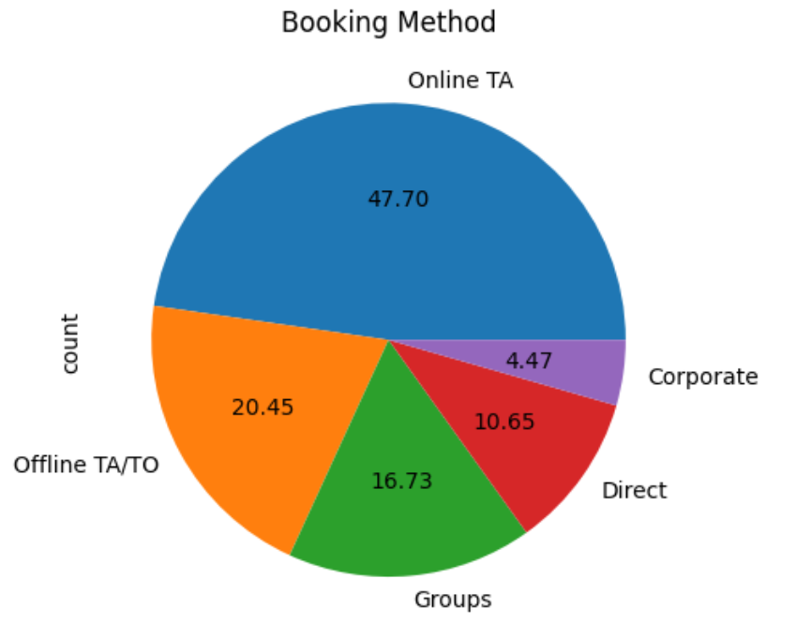
Around 47% of the clients come from online travel agencies, 20% come from offline travel agency, whereas 17% come from groups, 10% clients are come directly and Only 4% clients book hotels by corporate and making reservations.

Slide 12
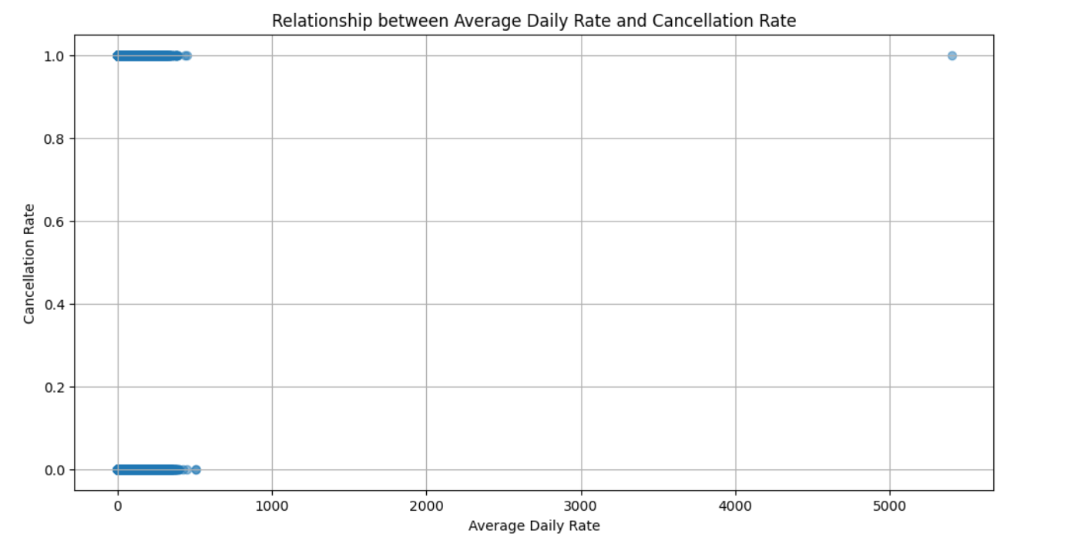
From this Scatter graph it appears that there is a trend where higher average daily rates are associated with a higher cancellation rate. This suggests that high prices may lead to a higher cancellation rate for hotel bookings.

Slide 13
Suggestions
1. Cancellation rates rise as the price does. In order to prevent cancellations of reservations, hotels could work on their pricing strategies and try to lower the rates for specific hotels based on locations. They can also provide some discounts to the consumers.
2. As the ratio of the cancellation and not cancellation of the resort hotel is higher in the resort hotel than the city hotels. So the hotels should provide a reasonable discount on the room prices on weekends or on holidays.
3. In the month of January, hotels can start campaigns or marketing with a reasonable amount to increase their revenue as the cancellation is the highest in this month.
4. They can also increase the quality of their hotels and their services mainly in Portugal to reduce the cancellation rate.

